Slide 1


PRE-WRITING TIPS
Writing Support Desk
writingsupport@uwindsor.ca

Slide 2
WHAT DO YOU DO
BEFORE YOU WRITE?

Slide 3

go to menti.com

Slide 4
PRE-WRITING:
WHY BOTHER?

Slide 5

Understand the prompt
Manage time
Develop a research strategy
Organize ideas
Develop a blueprint

Slide 6
STEP-BY-STEP
1. Analyze Prompt
2. Research
3. Organize Ideas

Slide 7

STEP ONE: ANALYZE PROMPT
4

Slide 8
WHAT KIND OF ASSIGNMENT IS IT?
6

Slide 9
go to menti.com

Slide 10
WHAT KIND OF ASSIGNMENT IS IT?
Research paper
Personal/Reflective response
Paper proposal
Persuasive essay
Compare and contrast
Creative project
Literature review
Annotated bibliography
Case study
Lab report
6

Slide 11

COMMON COMMAND WORDS
Define
Summarize
Compare/Contrast
Critique
Analyze
Evaluate
Reflect
6

Slide 12

OTHER REQUIREMENTS?
Page count?
Mandatory sources?
Certain number of sources?
Questions to answer?
Citation style?
Formatting?
Rubric?
6

Slide 13

PRO TIP: MAKE A CHECKLIST!
4

Slide 14
Define
1. Read page 29
Define a polar covalent bond using examples from page 29 in your text. Compare and contrast the features of polar covalent bonds with other types of chemical bonds. Given this information, determine whether Experiment X will create a polar covalent bond, a nonpolar covalent bond, or an ionic bond. Explain.
page 29
Compare and
2. Define ‘polar covalent bond’
contrast
3. Outline similarities & differences between types of bonds
determine
4. Predict Experiment X’s outcome
5. Provide reasoning for your prediction
Explain.
14

Slide 15

SO… WHAT’S YOUR TOPIC?
4

Slide 16

TOPIC
Object, idea, or theory you are writing about
‘Write a paper about dogs’: dogs = topic
‘Write a paper about WWII’: WWII = topic
Not the same as a research question
8

Slide 17
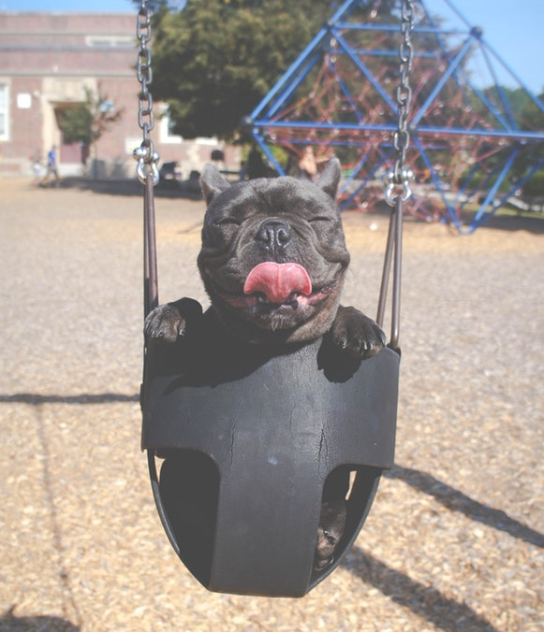
RESEARCH QUESTION
Narrows the topic into something specific to research
Dogs = topic
“How does feeding schedule influence dogs’ body mass?” = research question
WWII = topic
“What factors influenced America’s entrance into WWII?” = research question
8

Slide 18

STEP TWO: RESEARCH
4

Slide 19

WHERE TO START?
Pick out key words in your research question
“How does feeding schedule influence dogs’ body mass?” = research question
“dogs” “body mass” “feeding” “schedule”
Let research inform your writing (try a different question/approach!)
8

Slide 20

KINDS OF SOURCES?
Scholarly articles & peer-reviewed articles
Archival information
Statistics
Newspapers
Websites
Blogs
Remember to check what kinds of sources are mandatory for your assignment! If unsure, talk to your prof or GA.
8

Slide 21
go to menti.com

Slide 22

WHERE TO START FINDING INFORMATION?
Course textbook/notes
Google/Wikipedia (for general info only)
Bibliography mining
Leddy Library
YOUR LIBRARIAN (each discipline has one!)
Google Scholar
Leddy databases/ one-stop shop
8

Slide 23

Google Scholar

Slide 24


Slide 25
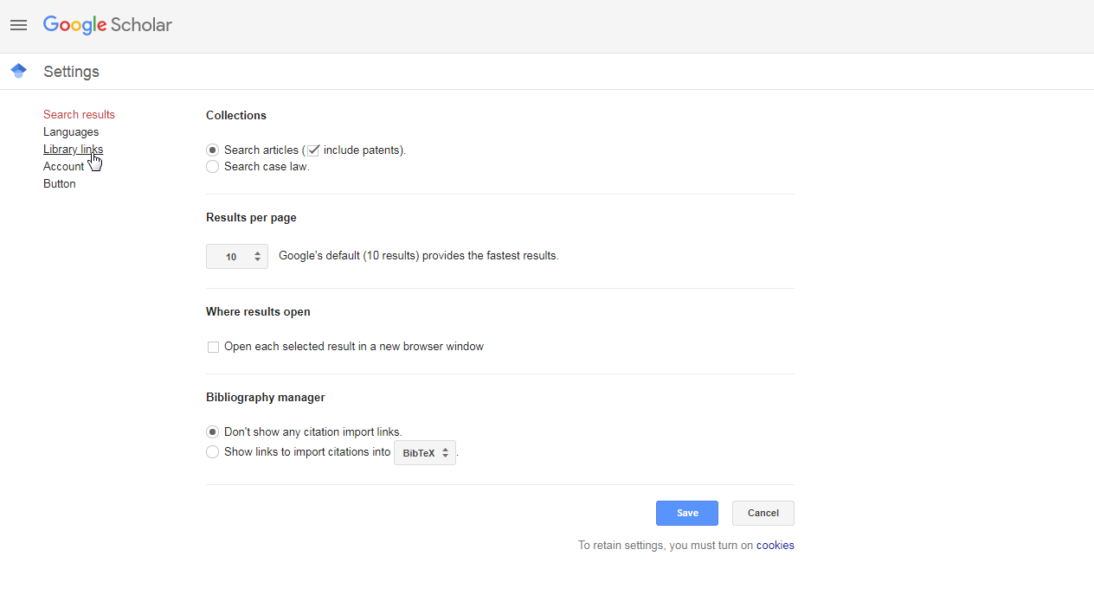

Slide 26
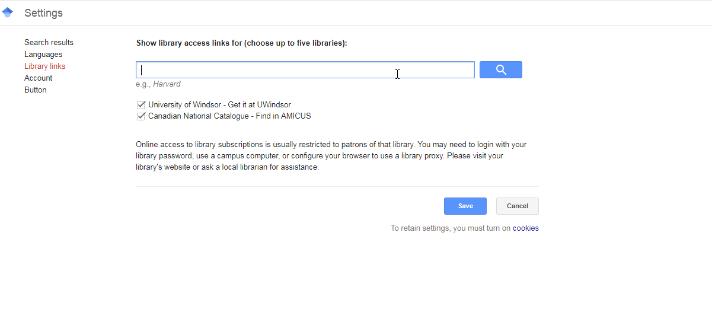

Slide 27

EVALUATING SOURCES
4

Slide 28

C R A A P
The
urrency
elevance
uthority
ccuracy
urpose
Test
4

Slide 29

CURRENCY
When was it first published?
When was it updated?
Does your project require more recent information?
8

Slide 30

RELEVANCE
Is the source related to your topic?
Does it fit the requirements of your assignment?
Who is the intended audience?
8

Slide 31

AUTHORITY
Who is the author?
Who is the publisher?
What are their credentials?
What is the publication process? Peer-review?
8

Slide 32

ACCURACY
Where is the info from?
Are arguments well-supported?
Are there references? What kind?
Peer-reviewed?
8

Slide 33

PURPOSE
Is it meant for education? Entertainment? To sell something?
Who funds it?
What bias is there?
Is it fact or opinion?
8

Slide 34

KEEP TRACK AS YOU GO!
Start a document to keep track of sources
Save website/doi, author name, article title, and date
Paste important quotes/info under each with page numbers
Colour code/highlight
Start formatting references as you go to save time later
8

Slide 35

STEP THREE: ORGANIZE
4

Slide 36
go to menti.com

Slide 37

BRAINSTORMING
Listing
Mind-mapping
Collaborating
Free writing
8

Slide 38
DOUBLE-SIDED JOURNAL
ONE SIDE SUMMARIZES RESOURCE MATERIAL
What are the main ideas?
What perspective does the author take?
What types of evidence does the author use?
ONE SIDE RECORDS YOUR RESPONSE TO IT
Do you agree or disagree?
How does it differ from your perspective?
Are there any discrepancies in the evidence?
38

Slide 39

NARROW FOCUS
By demographic? Time? Place?
By approach? Cause/Effect? Compare/Contrast? Process?
Remember, you can’t cover EVERYTHING in one paper!
8

Slide 40
BEFORE YOU START WRITING CHECKLIST
Have you analyzed and understood the assignment?
Do you know enough about the topic to write an informed response?
Are your ideas clear to you? Can you make them clear to others?
If so, you’re ready to get started!
40

Slide 41
QUESTIONS?
Remember, this slideshow and many others are available to download via the Writing Support Brightspace page.
Students can self-enroll as 'learners' either by selecting 'Discover' from the Brightspace landing page and clicking 'Enroll' on the Writing Support organization.

